Slide 1
Sentiment Analysis on British Airways Reviews.
By Dionisius Andrean Sihombing

Slide 2
Table of Content
Dataset
Text Preprocessing
Sentiment Analysis of Reviews
Word Cloud of Reviews
Sentiment Analysis of Verified
Sentiment Analysis of Unverified Reviews
Conclusion

Slide 3
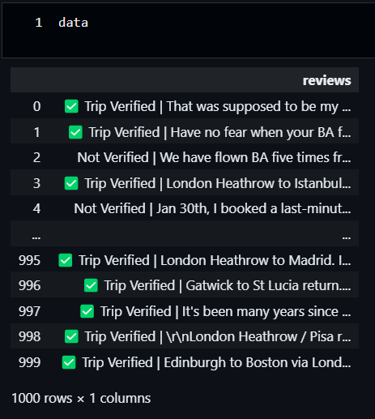
Dataset
Obtain insights for a sentiment analyzer, by scraping reviews from https://www.airlinequality.com/airline-reviews/british-airways.
Scraped 1000 reviews

Slide 4
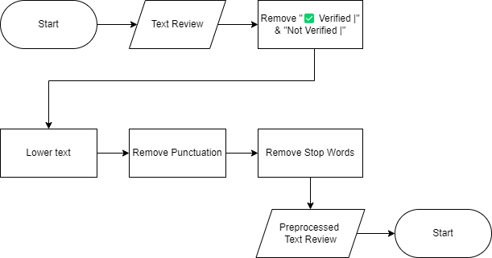
Text Preprocessing

Slide 5
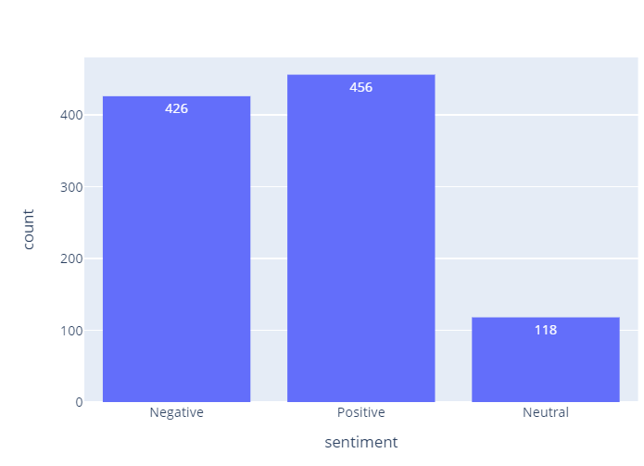
Sentiment Analysis of Reviews
According to VADER (Valence Aware Dictionary and sEntiment Reasoner) for sentiment analysis, most of the reviews are positive with 456 reviews and negative with 426 Reviews.

Slide 6
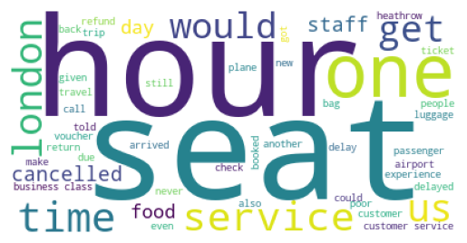
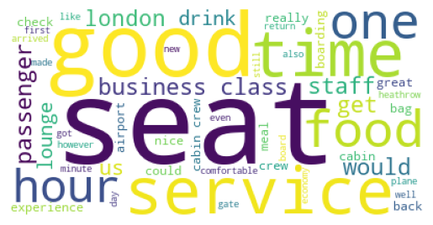
Word Cloud of Reviews
Find the most frequent words from each sentiments. For this section, additional stop words were included. It’s "british","ba", "airways", "fly", "flight", "airline", "aircraft", and "flights".
From positive review: Satisfaction on seat, service, and time.
From negative review: disappointment on hour/time, service, and time.
Both sentiments have london and most same words, like seat.

Slide 7
Sentiment Analysis of Reviews
Positive Unverified Reviews
Negative Unverified Reviews
There are positive feedbacks on cabin, lounge, staff,and arrived.
There are issues about cancellation, refund, and delayed.
From those few words we can get some insights.

Slide 8
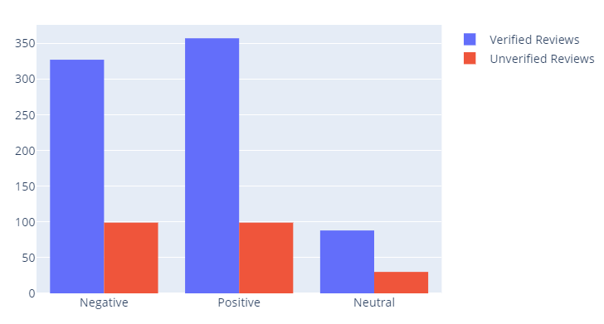
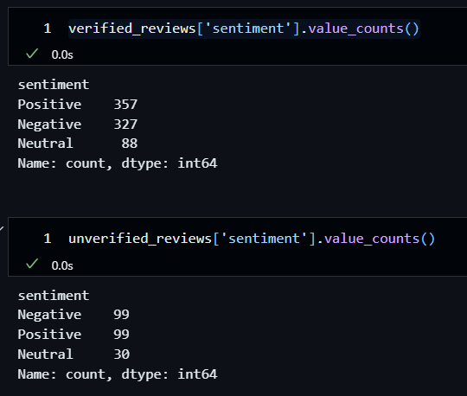
Sentiment Analysis of Verified and Unverified Reviews
There are 772 verified reviews, outnumbering the 228 unverified reviews.

Slide 9
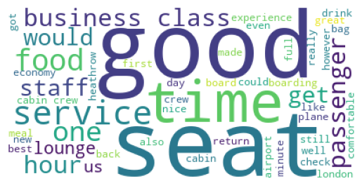
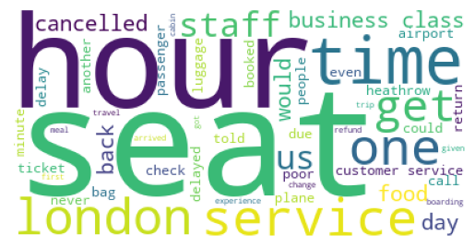
Word cloud of Verified Reviews
Positive Verified Reviews
Negative Verified Reviews
Verified reviews confirm the same insights as the last word cloud.

Slide 10
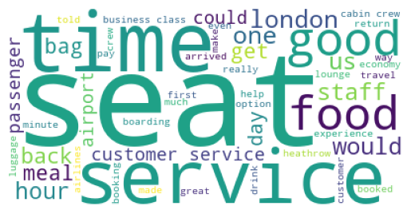
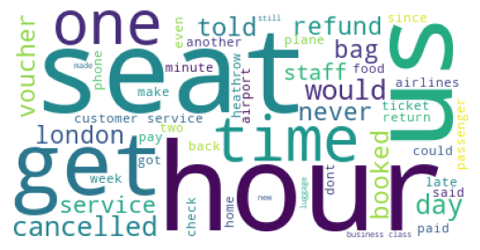
Word cloud of unverified Reviews
Positive Unverified Reviews
Negative Unverified Reviews
As well as unverified reviews.

Slide 11
Conclusion
Negative Verified Reviews
Negative Unverified Reviews
There are complaints about seats, service, and time that need to be investigated. Cancellation and delayed factors are one of the issues. Advises on improving our services and system.

